Slide 1
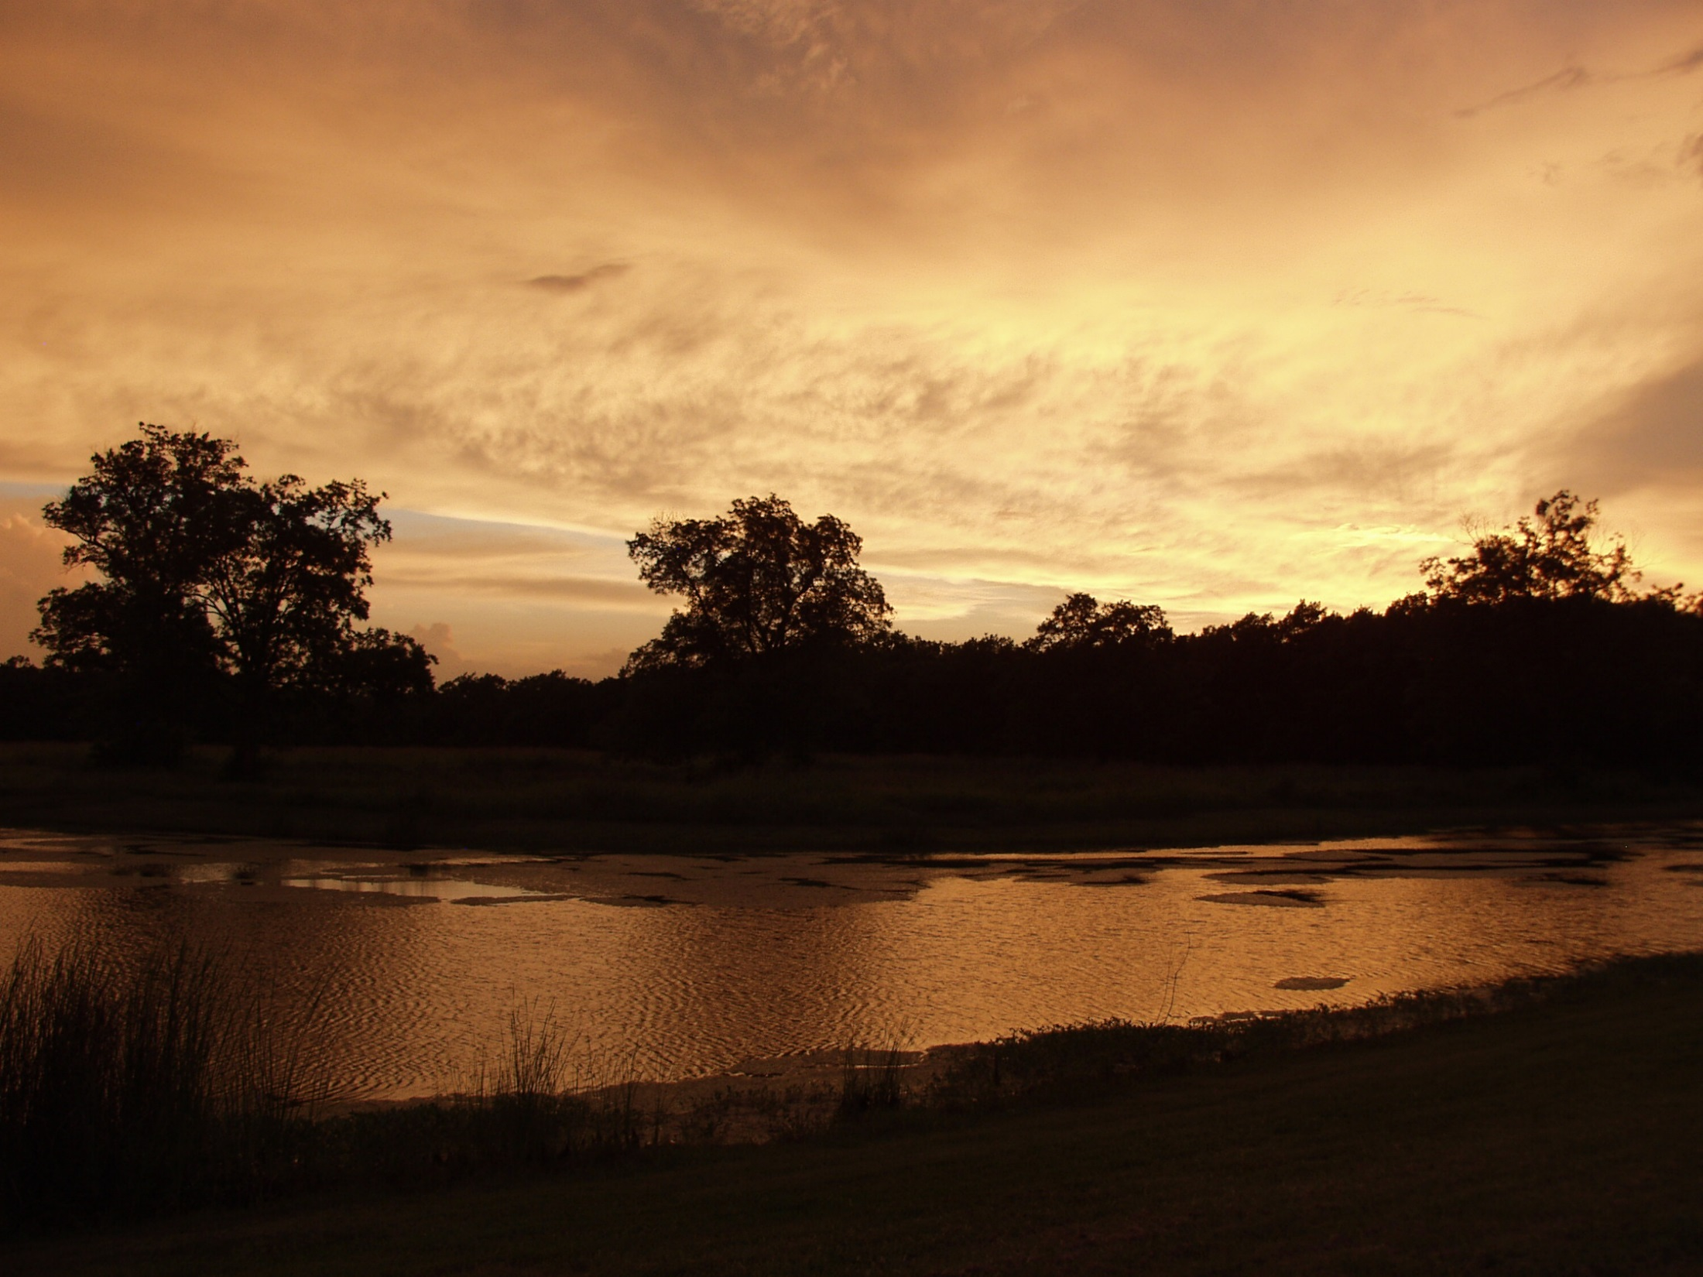
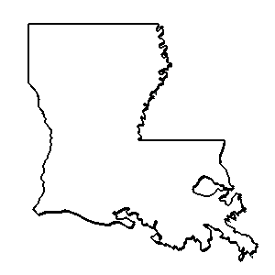

ouisiana
Anthology

Slide 2
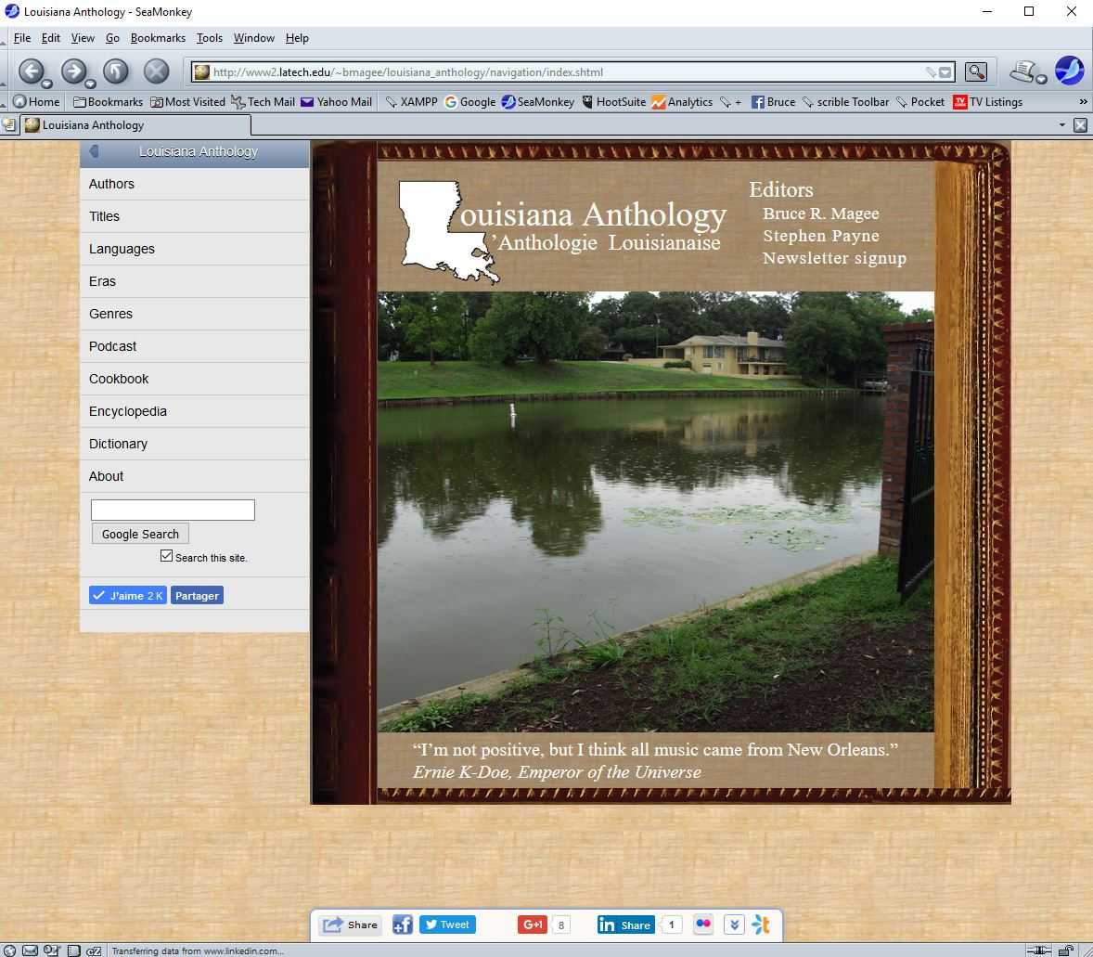

Slide 3


Slide 4
I. The Physical Landscape

Slide 5
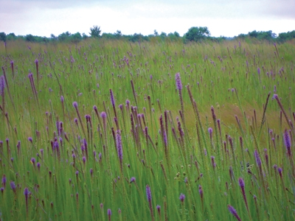
Louisiana prairie.

Slide 6
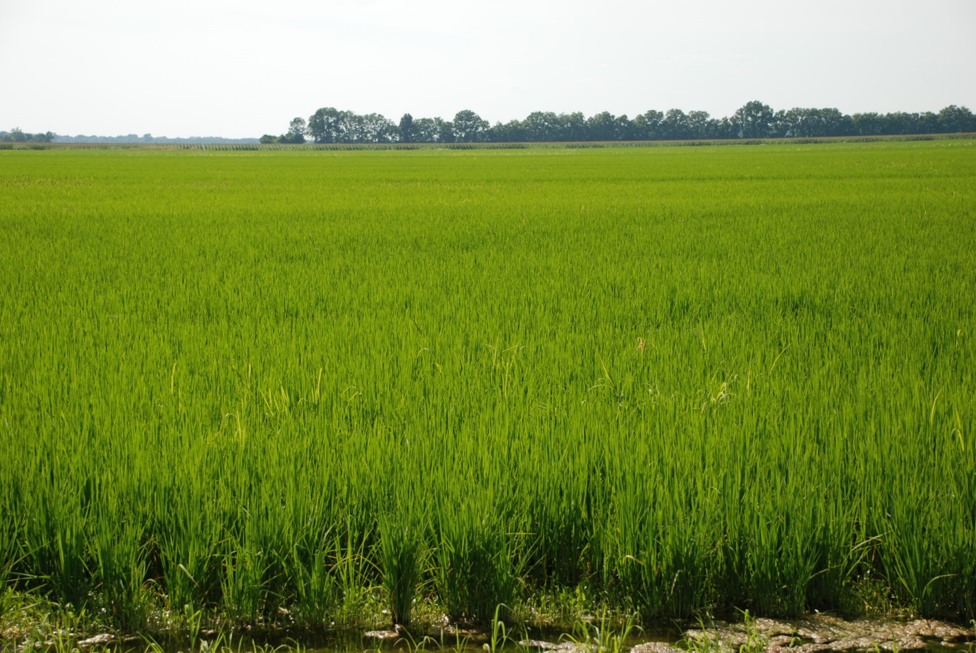

Slide 7
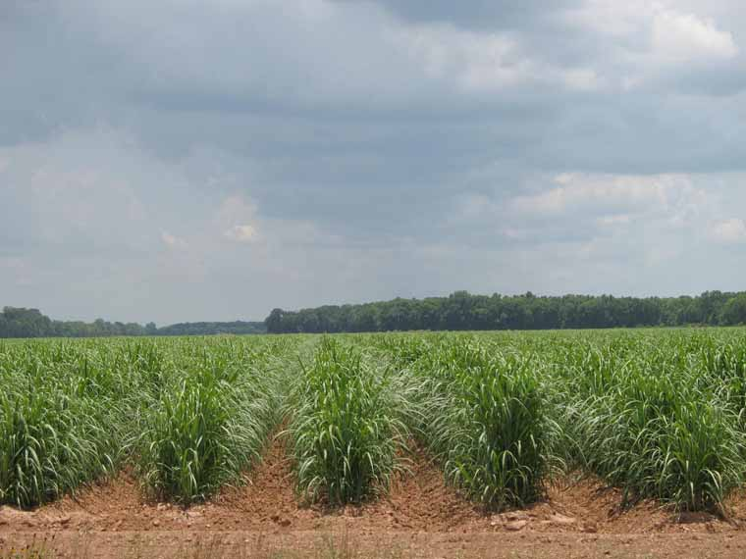

Slide 8
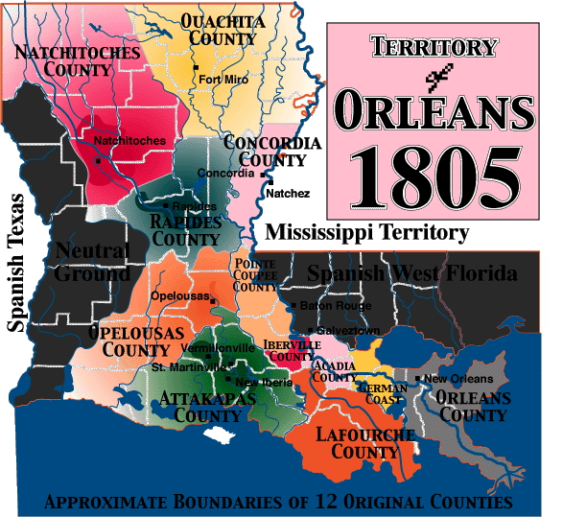

Slide 9
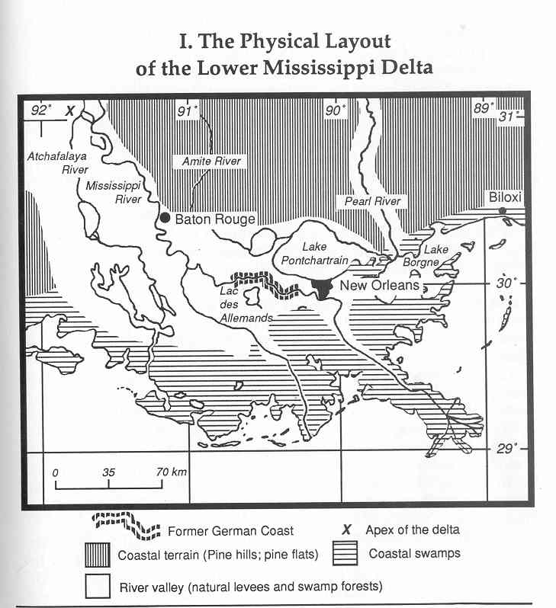

Slide 11
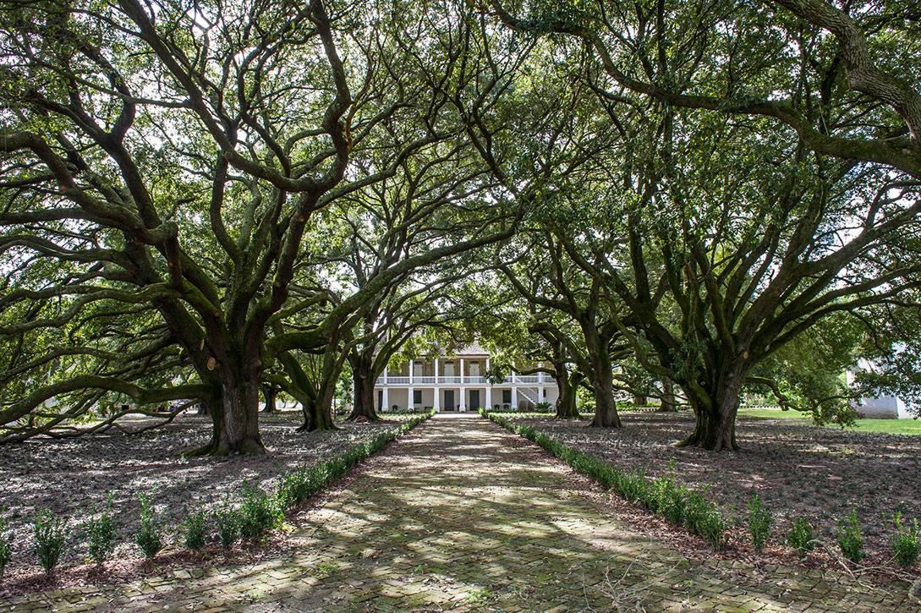

Slide 12
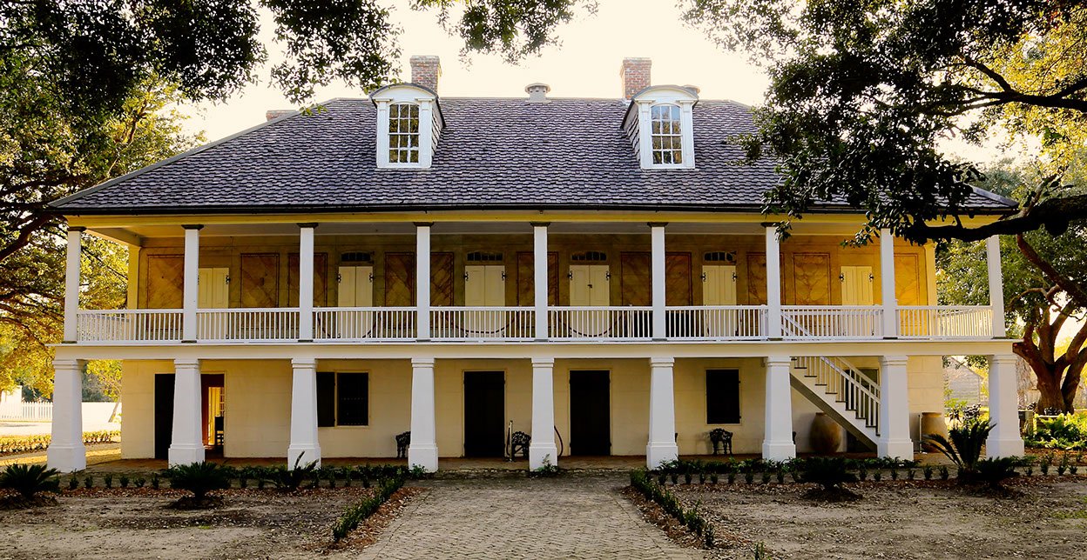
Creole Plantation.

Slide 13
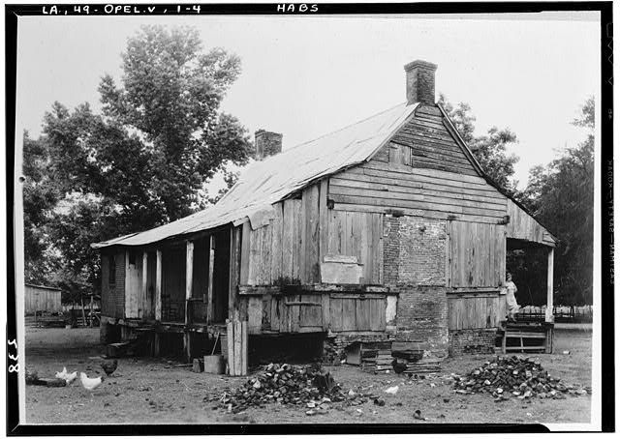
Acadian house.

Slide 14
The Social Landscape
A. Creole
B. ’Cadian/Cajun
C. “Negro Servant”
D. Spanish
E. Jewish Merchant
F. “Gens du Raiderode”
(Railroad workers)

Slide 15
