Slide 1

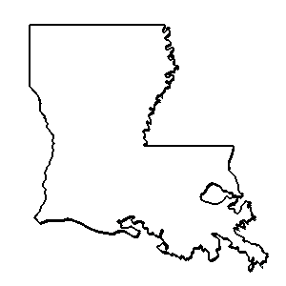

ouisiana
Anthology

Slide 2

“Mariaze Djabe.”
Bruce R. Magee & Stephen Payne

Slide 3
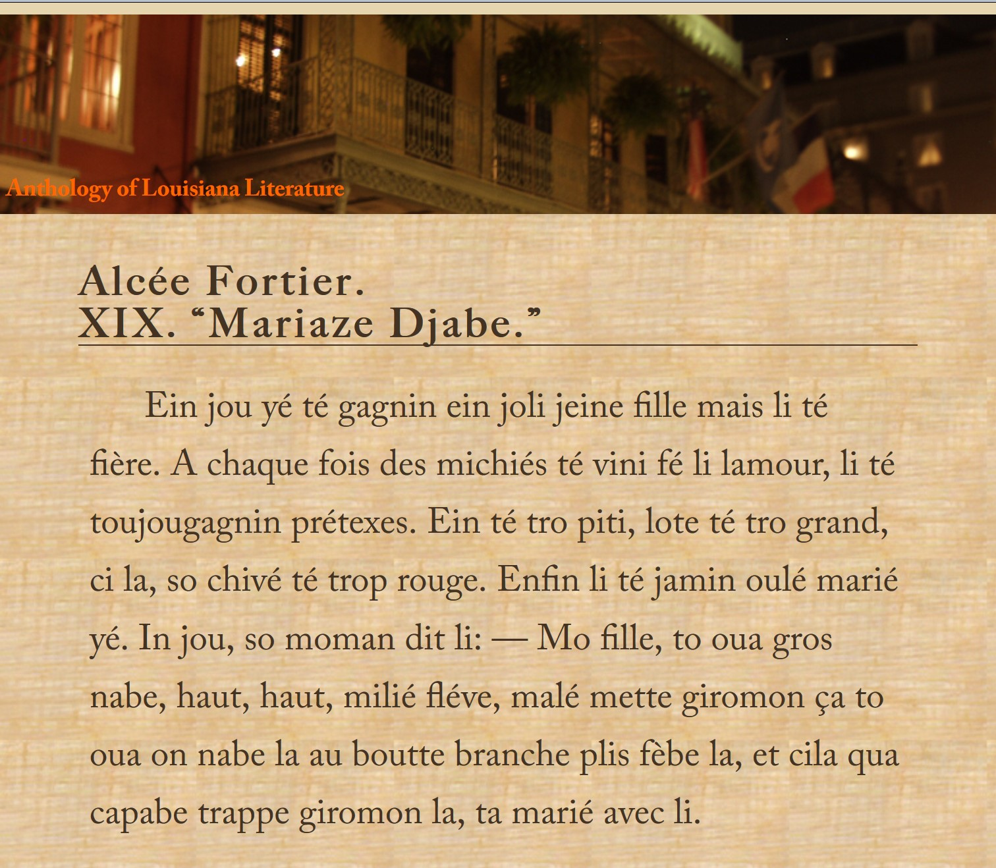

Slide 4
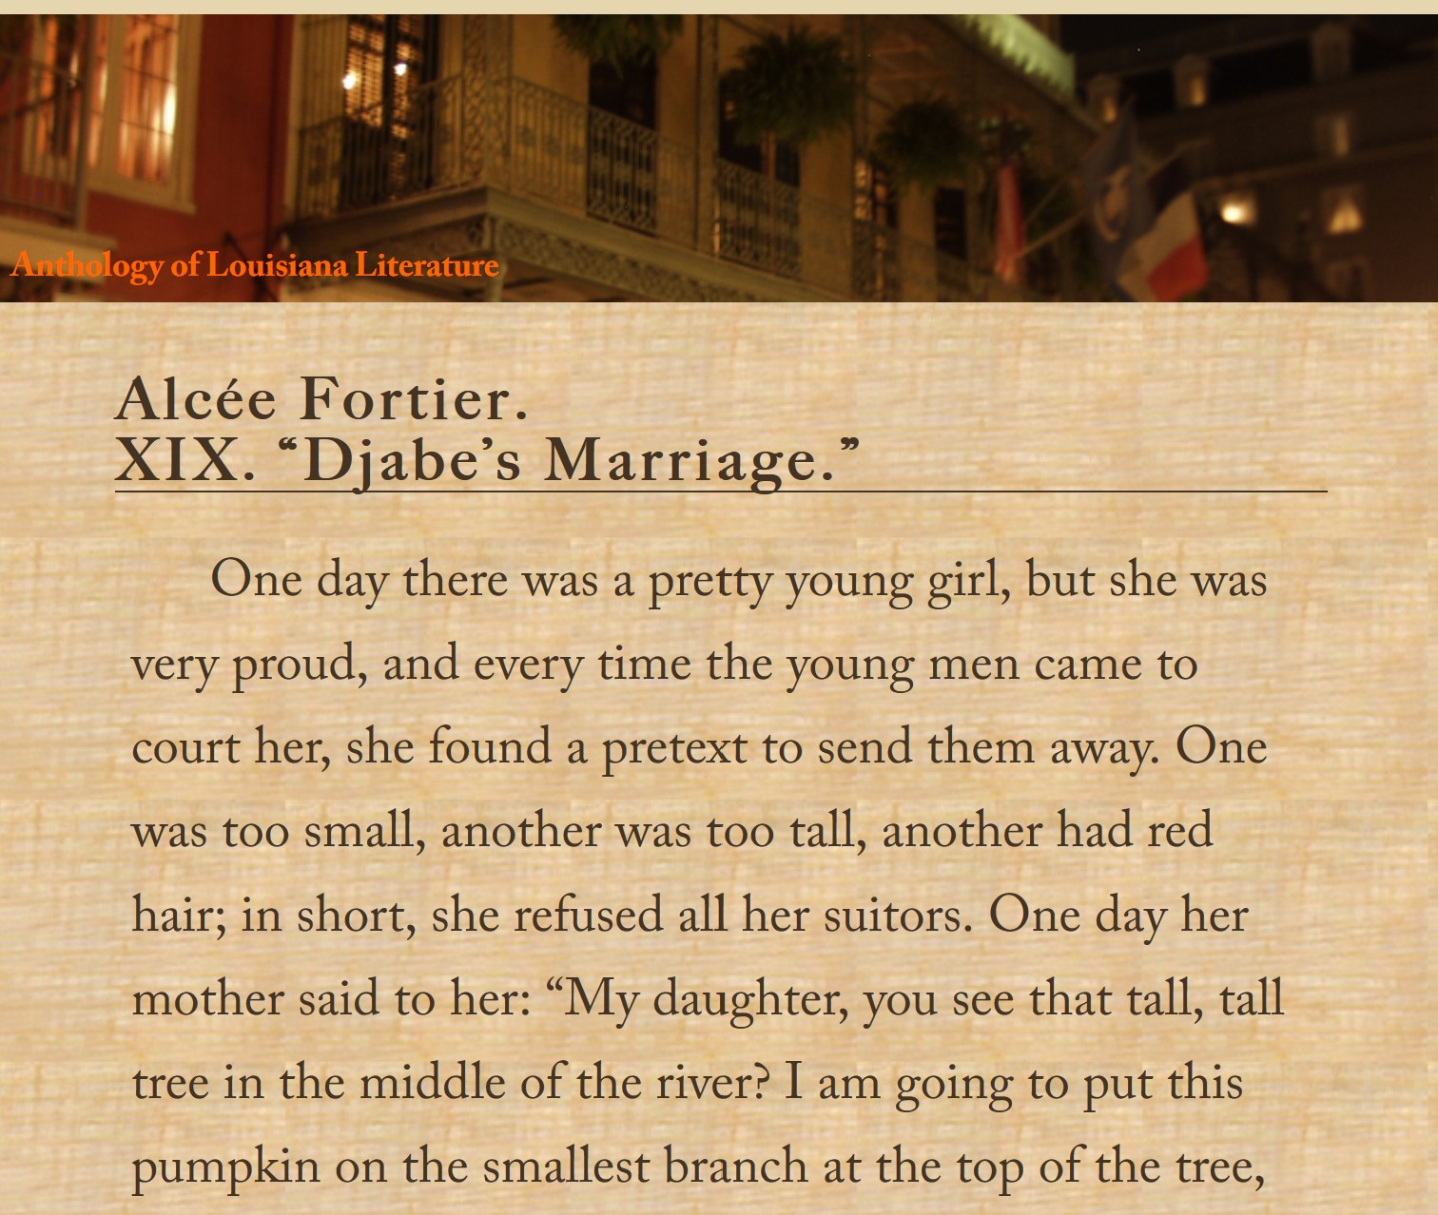

Slide 5
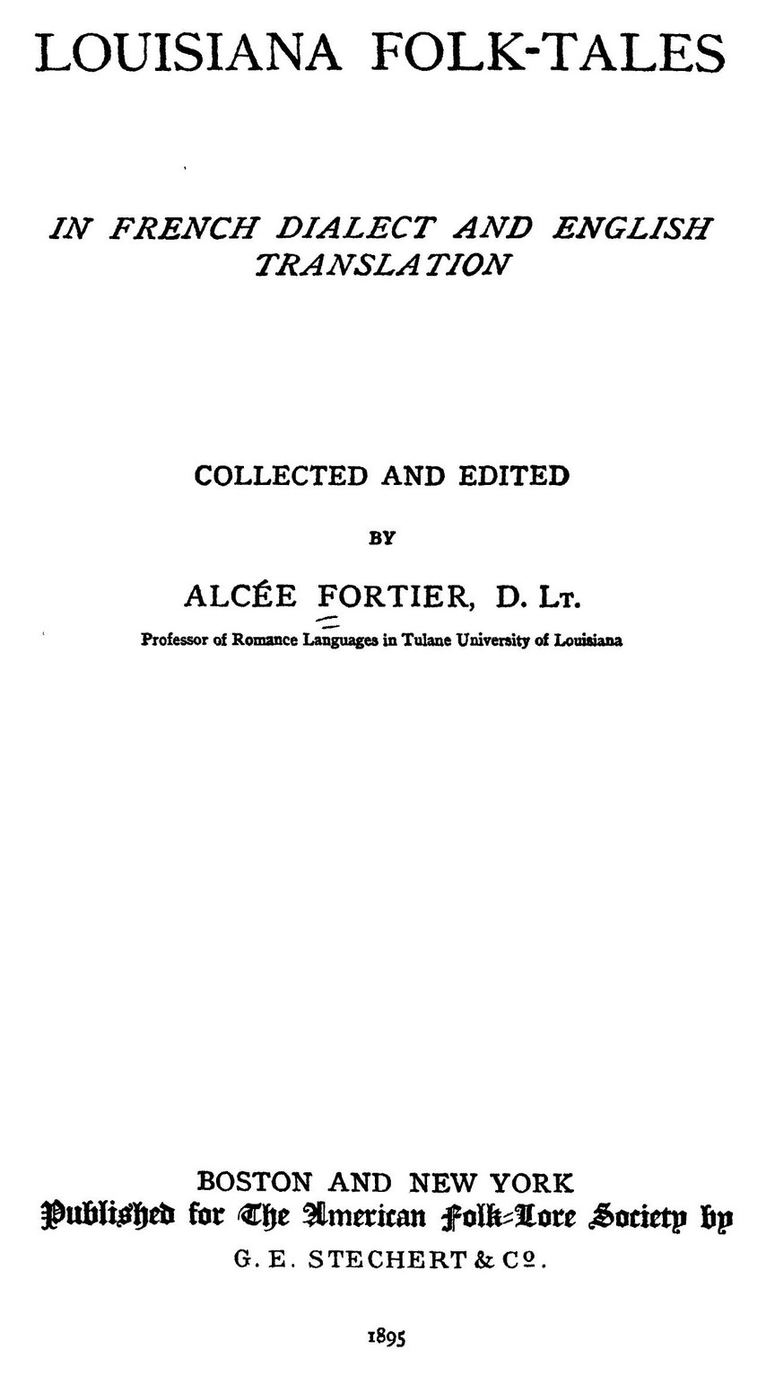
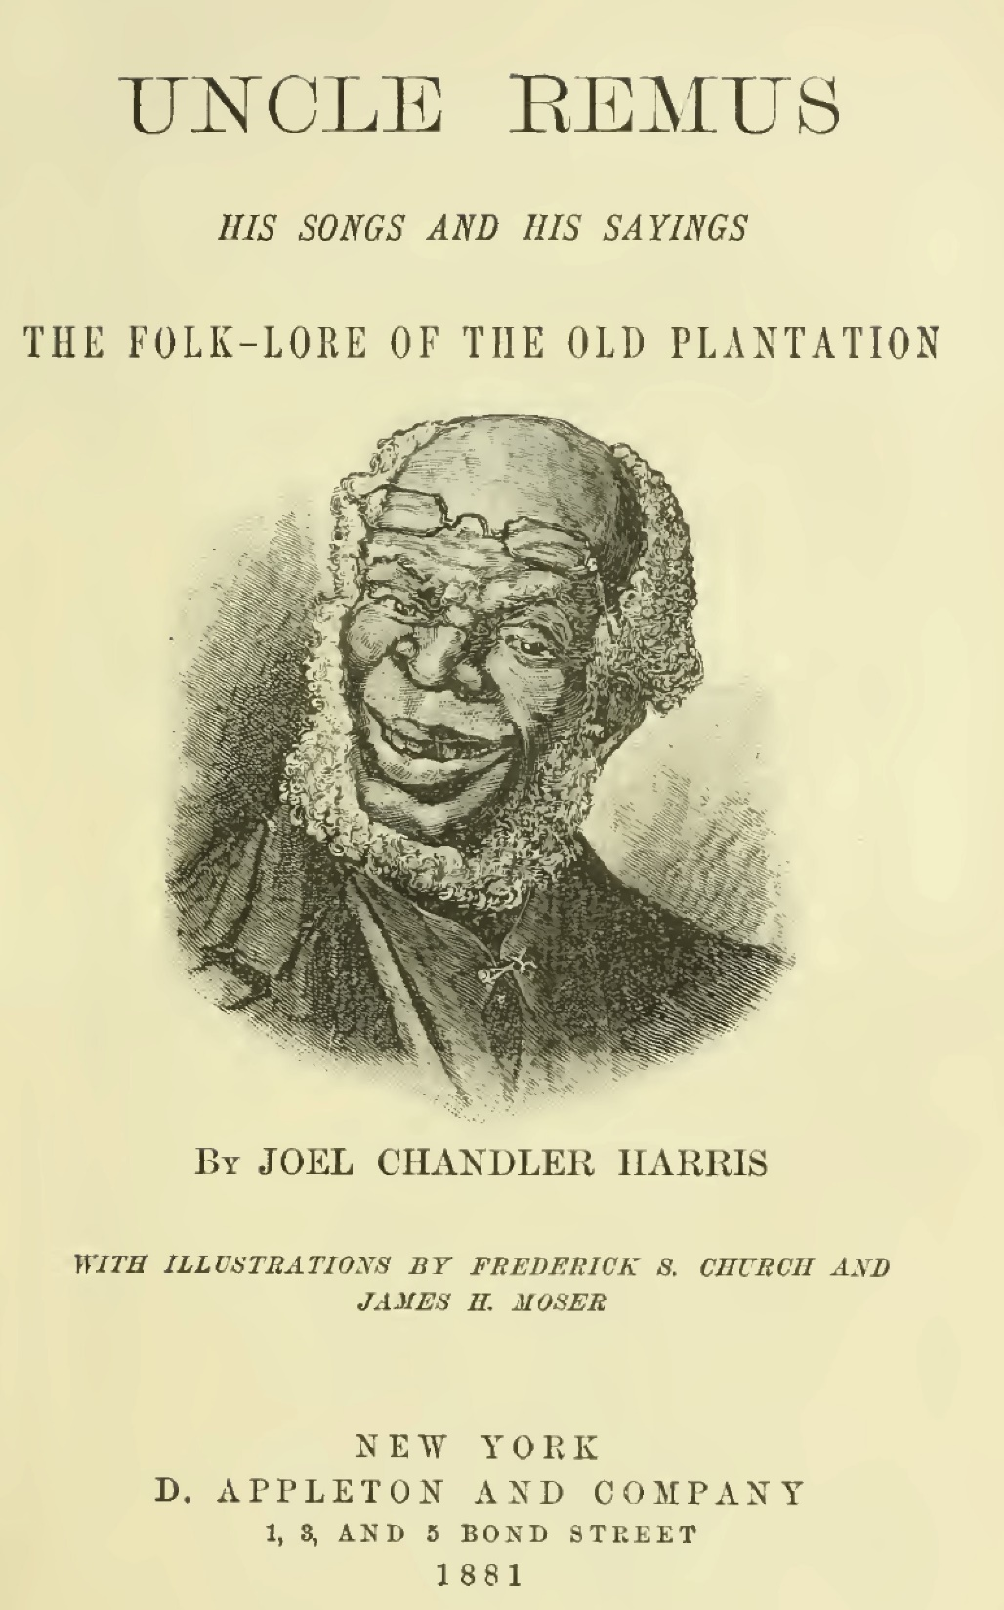
1895
1881

Slide 6
Who is Djabe?
The Devil. Fortier uses the translation for linguistic reasons. So does Lafcadio Hearn: “Gadé! djabe apé batte so femme.” (Look! the devil’s beating his wife!) (“New Orleans Superstitions.”)
Djabe, Djab (Creole) ??????
Le Diable (French). A devil, the devil.
Diabolos (Latin). A devil, the devil.
Diaboloj (Greek). Slanderer, enemy, the Devil.
הַשָּׂטָן. ha-satan. The adversary, the accuser, Satan. Job 1.

Slide 7
2. A powerful voodoo spirit.
Djabe. Fortier translated the word “djabe” as “devil”; the
word “djab” is indeed derived from the French word
“diable” (devil), but the idea behind the djab is unrelated
to the devil in the Christian sense of the word. Instead,
it is an earthbound voodoo spirit, a spirit that can be
associated with an individual. They are thus like the
Djinns (genies) of Islam. The djab can perform various
tasks, including draining the life out of the victim. During
the Hatian Revolution, they were publically credited
with protecting the revolutionaries. They are still in
important component of Haitian Vodou among the
bokors that conjure them. This djab can show up looking
like Papa Ghede or Baron Samedi. (Special thanks to
Denise Alvarado for helping with the note.)

Slide 8
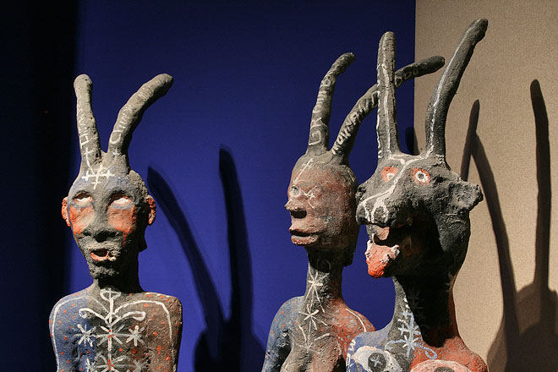
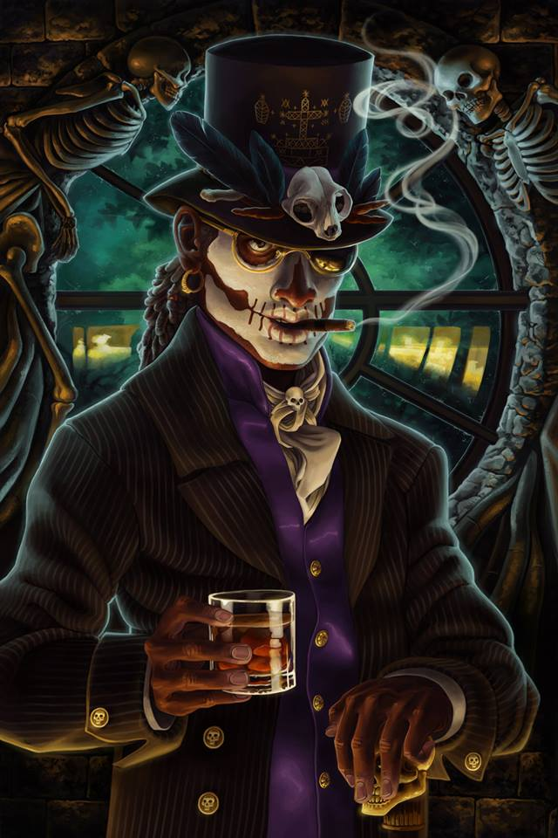

Slide 9
Djabe wins the contest.
Marries the girl.
Starts home.
Has to return his finery along the way.
Finally has to give back his 4 fine horses.
Goes into the woods & restores his clothes.
Forces his wife to pull the carriage the rest of the way home.
His mother shows her a room with the bodies of his previous wives.

Slide 10

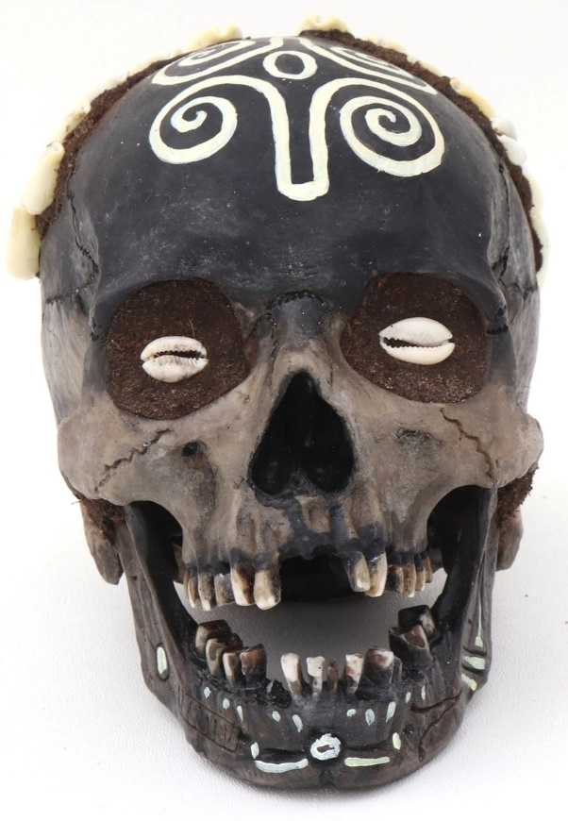
The Disobedient DaughterWho Married a Skull
Beautiful daughter won’t marry any of the old men her father picks out.
Skull borrows arms, legs, etc., to come woo.
She marries, goes to the spirit world, and helps her mother-in-law.
Mother-in-law & Spider help her escape back home to escape spirits.
She marries her father’s friend. Village outlaws exogamy.

Slide 11
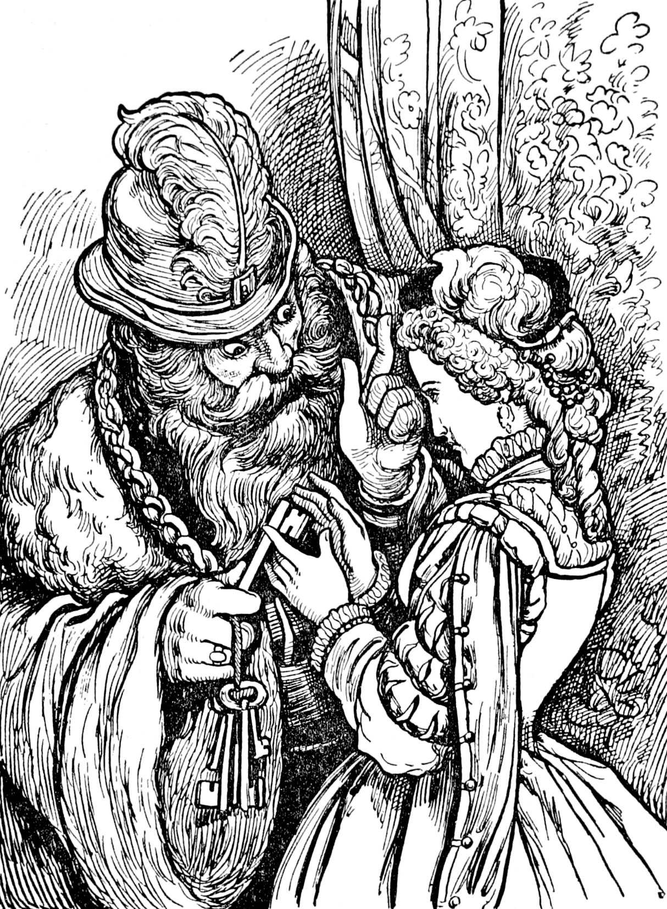
“Barbe bleue,”
“Bluebeard”
Charles Perrault.
Histoires ou Contes du
Temps passé, subtitled
Les Contes de ma Mère l’Oye
Tales of Mother Goose
Blue Beard is rich, but he has a blue beard.
Throws a week-long party, so one of the girls decides to marry him.
Gives her the keys to all the rooms in the house, warns her not to go into one of the closets.

Slide 12
“Bluebeard”
“After some moments she began to perceive that the floor was all covered over with clotted blood, on which lay the bodies of several dead women, ranged against the walls. (These were all the wives whom Blue Beard had married and murdered, one after another.)”
“Mariaze Djabe.”
“As soon as he was gone the mother said to the young lady: ‘Ah! my daughter, you have taken a bad husband; you have
married Djabe. . . . come, let me show you something.’ She opened the door of a little room, and said: ‘Look, my daughter.’ The girl looked in the room, and what did she see? A number of women hanging from a nail.”

Slide 13
“Bluebeard”
Upon this she threw herself at her husband's feet, and begged his pardon with all the signs of a true repentance, vowing that she would never more be disobedient. She would have melted a rock, so beautiful and sorrowful was she; but Blue Beard had a heart harder than any rock!
“You must die, madam,” said he, “at once.”
“Since I must die,” answered she (looking upon him with her eyes all bathed in tears), “give me some little time to say my prayers.”
“I give you,” replied Blue Beard, “half a quarter of an hour, but not one moment more.”
*Eventually her brothers save her.*

Slide 14
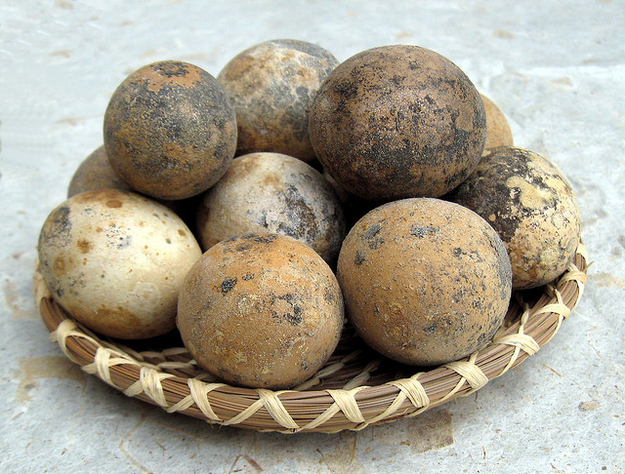
“Mariaze Djabe.”
Djabe’s mother gives her 6 dirty eggs
High wooden fence vs golden axe.
Iron fence vs golden axe.
Fire in road vs jar of water.
Brick wall vs golden axe.
Small river with canoe for her. He had to swim.
Large river. Crocodile gives her a ride, drowns Djabe.

Slide 15
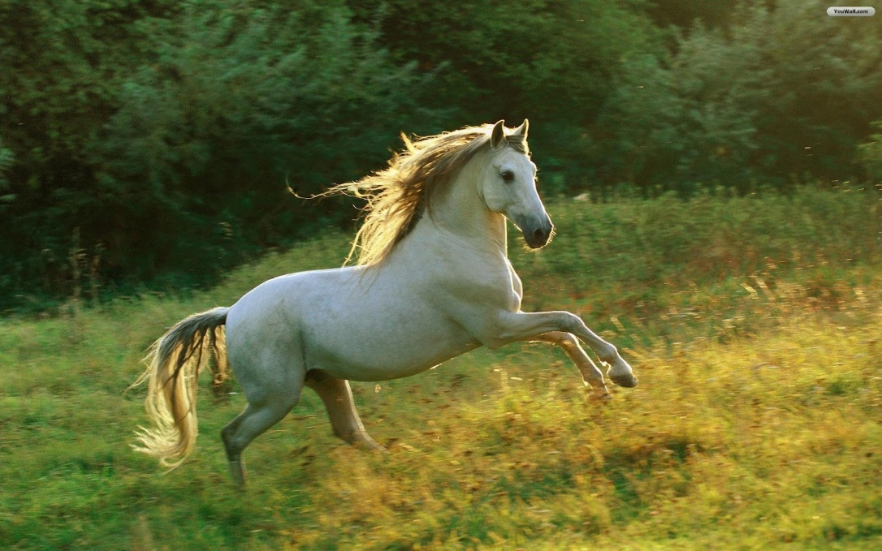
When the girl had left her mothers house with her husband, her mother had said to her: “Well, my child, what do you wish me to do with your old white horse?” The girl said to her mother: “I don’t care what you do; put him out in the pasture and let him die if he wants to.” However, when she crossed the river on the crocodile’s back, she saw her old horse in the pasture, and she said to him: “I pray you, old body, save my life!” The horse replied: “Ah, you want me now to save your life; did you not tell your mother to let me die, if I wanted? Well, climb on my back, I shall carry you to your mother.”

Slide 16


