Slide 1
Analysis Essay
All The King’s Men

Slide 2
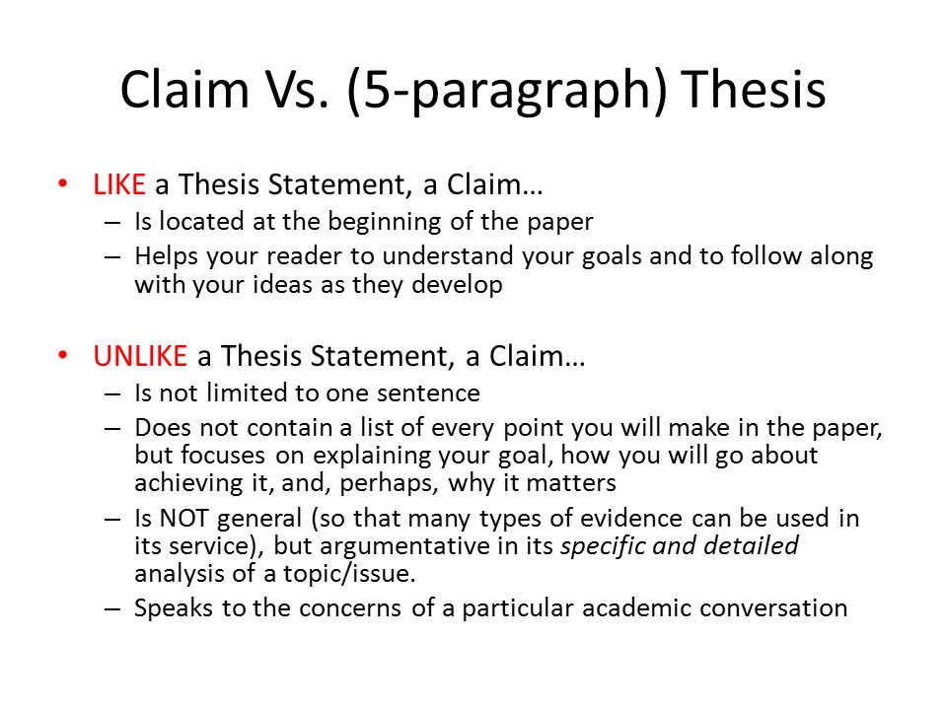
Claim versus Thesis
A claim must be arguable but stated as a fact. It must be debatable with inquiry and evidence; it is not a personal opinion or feeling.
A claim defines your writing's goals, direction, and scope.
A good claim is specific and asserts a focused argument.

Slide 3
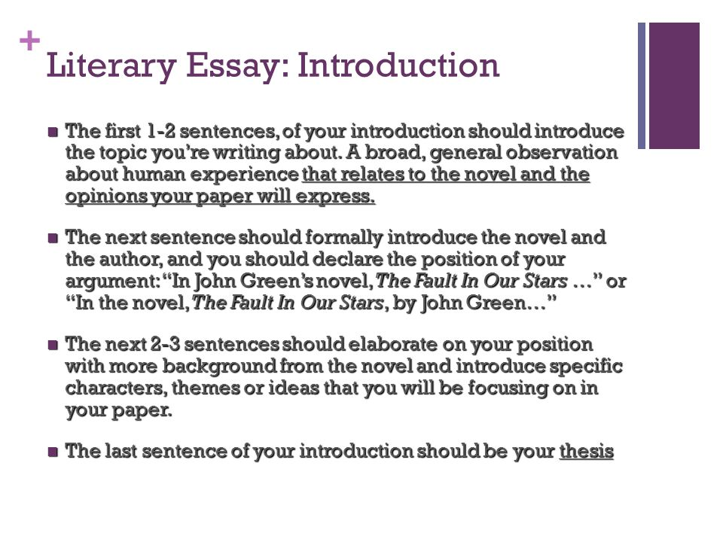
MAKE YOUR CLAIM

Slide 4
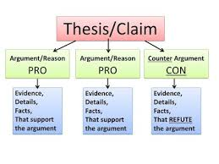
What are you trying to prove as a result of your paper?

Slide 5

Every CLAIM OR ARGUMENT must be supported
Ways to support:
State the claim
Give evidence to support
Quotes directly from the text
Use information from literary articles
Explain how the evidence supports the claim

Slide 6
Use Boxes and Bullets to Plan Your Arguments/Claims
Claim 1
Statement
Quote
Claim 2
Claim 3

Slide 7
In-Text Citation If you use it, you must cite it.
When citing Shakespeare plays, list the ACT, SCENE, and LINES in parenthetical citations (page numbers are NOT included), separated by periods. Enclose the citation in parentheses. For example: (Macbeth 1.3. 14-18). END
OR
In Act 1, scene 3, lines 14-18 of Macbeth, the………….. (within paragraph)

Slide 8
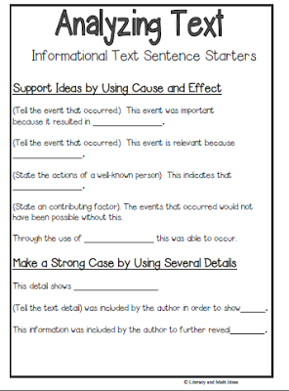
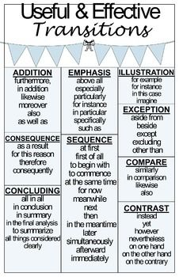
Incorporate Transitions and Analyze Text

Slide 9
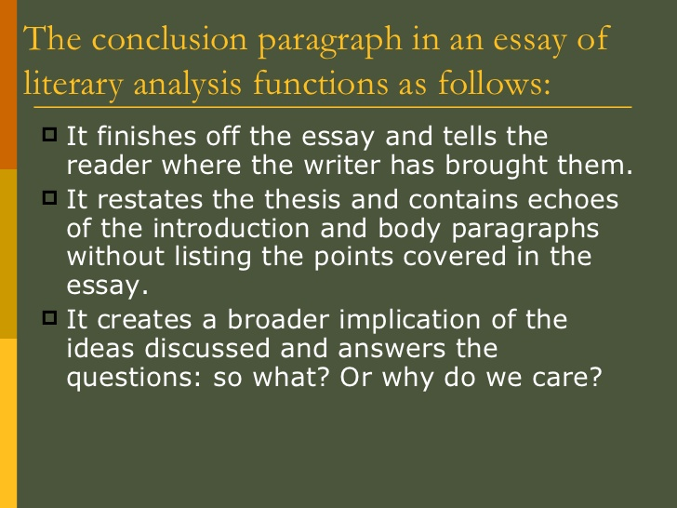
CONCLUSION

Slide 10
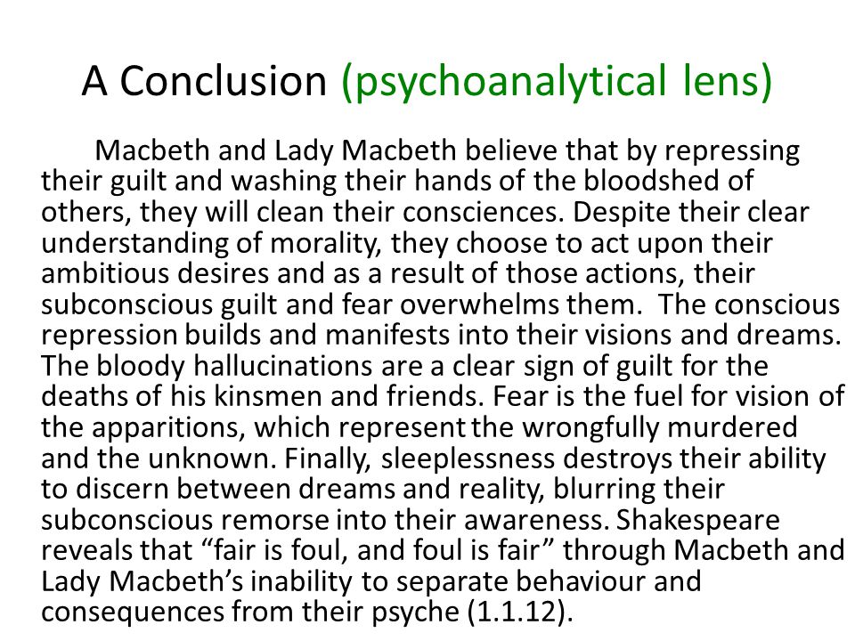
Sample

Slide 11
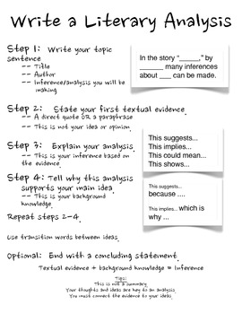
REVIEW Analysis ESSAY

Slide 12
REFER TO RUBRIC
Review SAMPLE MODEL
500-600 WORDS, Header, Rough Drafts Due by MID class Friday (25 pts)
Peer Editing to Occur 2nd Half
Final Drafts due Tuesday and Wednesday on Turnitin.com

