Slide 1
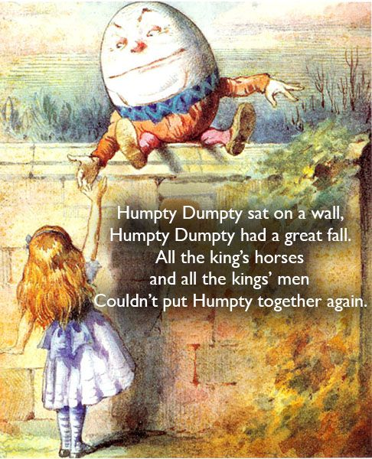
All the King’s Men
Published 1946
Genre: Drama
Author: Robert Penn Warren

Slide 2
The South in the 1920’s and 1930’s
Poverty consumed the South in20’s and 30’s.
The reason for the economic decline in the South can be traced to the collapse of the plantation system after the Civil War. Before the war, plantations grew large-scale “cash crops” such as cotton and used slave labor to farm the land.
Cass Mastern story ( shows a man’s struggle between plantation ownership and the guilt over the sale and familial separation of slaves. –cruelty of the slave system
After the Civil War, wealthy landowners set up sharecropping which allowed farmers to work the land in return for a share of the crop’s value and tenant farming – renting the land for use by farmers to maintain their cash crop economy. These two systems kept farmers in a state of poverty.

Slide 3
1930’s The Novel Begins
African Americans and rural whites had been working in a tenancy system – increased from 36 to 55 percent in the South.
Since Civil War, families steeped into poverty.
The main character – Willie Stark runs governor and promises to change this system .
Discrimination widespread against blacks in the South. An example in the novel is the commissioner and sheriff of Mason City who don’t hire a construction company because the company uses African American workers.
Discrimination was supported legally by the “Jim Crow” laws passed from 1877 to 1950’s. The laws enforced segregation and discrimination against blacks by limiting voting rights and forced them to use different facilities than whites.

Slide 4
The Ruling Class in the South
During Reconstruction in the South, wealth landowners and their associates, emerged as the ruling class. (EX: Judge Irwin, Gov. Stanton)
Elite class of men gained power by forming close knit groups that exerted political influence over the southern state for decades.
While the setting is not named, it can reasonably be presumed to be Louisiana since the character of Stark is based on longtime Louisiana governor Huey Long.
Bourbon Democrats reduced the investment infrastructure such as roads and railroads and social services such as education. In addition they lowered taxes on property owners. Even though the Bourbon Democrats had fallen from power in the early 1900’s, the elitists continued to exert influence in the 1920’s.
The plot of All of the King’s Men revolves around the need for reformation in a state government as a result of poor leadership.

Slide 5

Huey Long vs Willie Stark
HUEY LONG
WILLIE STARK
Charismatic governor of Louisiana 1926-1932.
Served in U.S Senate until 1935 when he was assassinated.
Was Willie a replica of Long?
Is Willie based of Long with few changes?
Find similarities and differences
Serves two terms as governor.
Does not have a politically active wife.
Dies because he is having an affair.
Dies before being elected to the Senate.

Slide 6

Perspective and Narrator
Perspective
Narrator and Point of View
Jack narrates his own story as well as the stories of Willie Stark, Cass Mastern, Judge Irwin, amongst others. Because all characters and events are filtered through Jack’s perspective, his emotional closeness to these stories brings his reliability into question.
Finally, because Jack quotes from Cass Mastern’s journal, Cass functions as a first-person narrator in these segments.
Jack Burden –narrator
First person

Slide 7
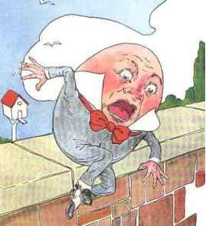

THE TITLE “ ALL THE KING”S MEN couldn’t put HUMPTY together AGAIN.”
The title comes from the nursey rhyme “Humpty Dumpty”
State Governor Willie’s Stark rises to political power or SITS on a wall.
After spending several years as a dominant governor of a
southern state, Willie has a great fall in “power.”
All of Willie’s political associates could not repair the damage.
INTERPRETATION:
Is Willie the king or does the king refer to someone or some forces more powerful than Willie such as God?

