Slide 1
Great Sleep and rebirth
Theme Components

Slide 2
Great sleep
A period of prolonged sleeping and idleness in Jack’s life.
He slips into these periods of inactivity/depression to try to escape his problems and to escape responsibility of past actions.
It shows Jack’s general lack of ambition and sense of purpose in life.

Slide 3
Jack falls into three periods of “Great sleep”
After he is unable to finish his graduate thesis on Cass Mastern
After his marriage to Lois falls apart
After he quits his job as a reporter

Slide 4
Rebirth – a progression that involves several steps.
A person is involved in a corrupt or irresponsible behavior.
This person has a shattering experience which confronts him with the consequences of his actions.
After realizing the harm done by the corruption and irresponsibility of others and themselves, they decide to change their ways.
The final step in the rebirth progression involves going out in the world and taking actions that reflect their new approach.

Slide 5

Rebirth
A one-line description of it.
https://www.youtube.com/watch?v+gcmeV83K02E

Slide 6
Willie
JACK
Jack refuses to take responsibility for his actions and as a result collects dirt on Willie.
Jack has several sobering experiences.
By telling Anne about her father’s scandal, he has disillusioned her – which leads to her affair with Willie.
By using a scandal against Judge Irwin, he causes the judge to commit suicide
Example: Willie’s early political career illustrates the theme of REBIRTH.
Willie believes after the school building scandal that he can be the SAVIOR for the state.
Willie has a spiritual and political rebirth as a reaction to the commisioner’s corruption. Inspired by righteous ideals, Willie honestly tries to win the nomination of the Democratic party.
SECOND REBIRTH
Caused by corruption
When willy realizes he is being manipulated to draw votes away from another candidate, he goes through a transformation process with Christian overtone.
Jack realizes not only the repercussions of his own actions but that of many other people.
Jack reflects on how many people he knows have taken irresponsible actions, causing suffering.
After realizing the harm done by CORRUPTION or by IRRESPONSIBILITY to others and themselves, they decide to change their ways.
Jack will do three things
Forgive his mother
Take care of ______________
_________________________

Slide 7
Why did Willie make a sudden shift from an honest politician shift from an honest politician to a corrupt one? If he truly believed in being honest, why did he decide to accept corrupt methods?
WILLIE
Hint -DUPLICITY
His hatred of being BELITTLED and OVERWHELMED his desire to BE HONEST.
Chapter 1 – Jack notes Willie’s congenial appearance but underneath is a façade of hardness.
Willie is driven by _____________, for the good of the people which supports his own _____________.
Willie can’t abide by being used or treated badly by others.
“ I BELIEVE ALL POLITICIANAS ARE CORRUPT AND ONLY DISHONEST MEANS CAN PRODUCE RESULTS.”

Slide 8
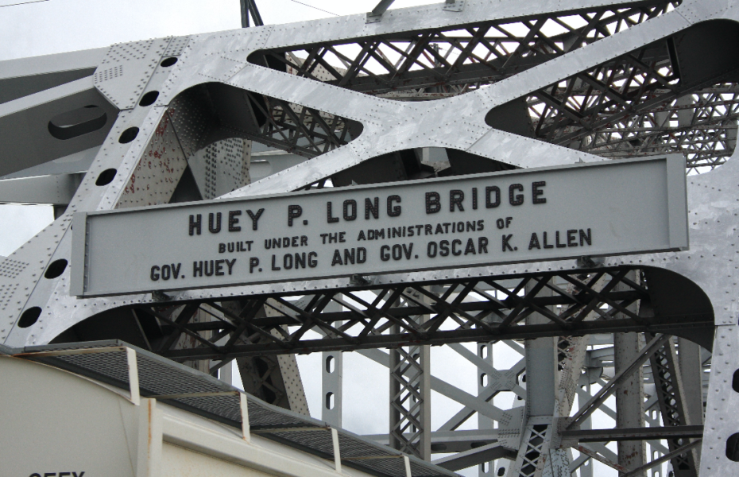
“This is the Most important take away that everyone has to remember.” from an expert

